Slide 1
Chapter 1 The Foundations : Logic and Proofs Kenneth H. Rosen 7th edition
Section 1.2 : Applications of Propositional Logic

Slide 2
Translating Into Logical Expressions
Translate the following sentences into logical expressions:
You can access the Internet from campus only if you are a computer science major or you are not a freshman.
You cannot ride the roller coaster if you are under 4 feet tall unless you are older than 16 years old.
The automated reply cannot be sent when the ﬁle system is full.

Slide 3
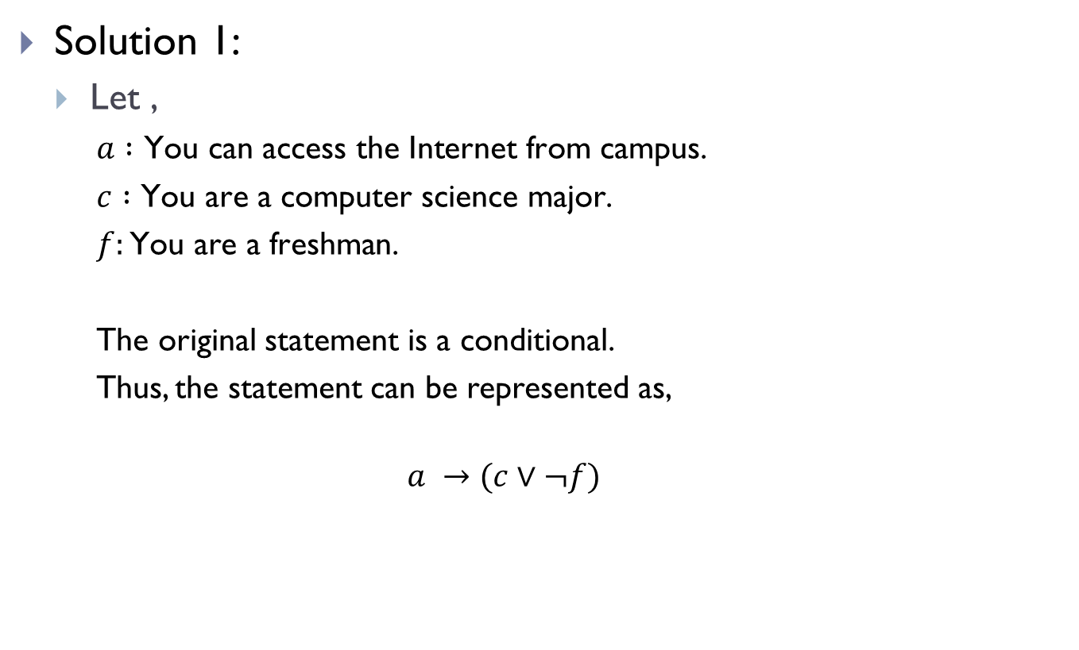
Translating Into Logical Expressions(Contd.)
Solution 1:
Let ,
$a :\text{You} \text{can} \text{access} \text{the} \text{Internet} \text{from} \text{campus}$.
$c :\text{You} \text{are} \text{a} \text{computer} \text{science} \text{major}$.
$f:\text{You} \text{are} \text{a} \text{freshman}$.
The original statement is a conditional.
Thus, the statement can be represented as,
$$a →(c∨¬f)$$

Slide 4
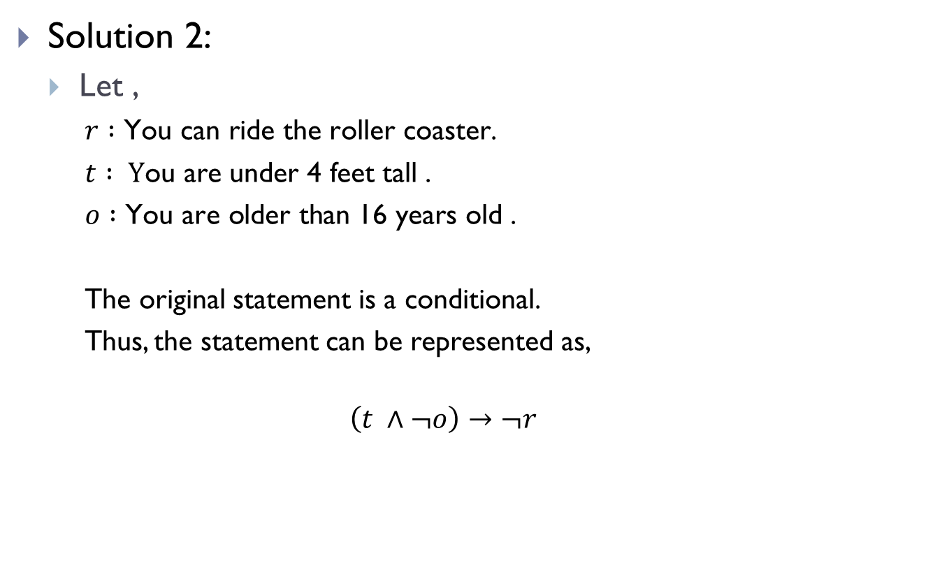
Translating Into Logical Expressions(Contd.)
Solution 2:
Let ,
$r :\text{You} \text{can} \text{ride} \text{the} \text{roller} \text{coaster}$.
$t : \text{Y}\text{ou} \text{are} \text{under}\text{ 4 }\text{feet} \text{tall}$ .
$o :\text{You} \text{are} \text{older} \text{than}\text{ 16 }\text{years} \text{old}$ .
The original statement is a conditional.
Thus, the statement can be represented as,
$$\left(t ∧¬o\right)→¬r$$

Slide 5

Translating Into Logical Expressions(Contd.)
Solution 3:
Let,
$f :\text{The}\text{ ﬁ}\text{le} \text{system} \text{is} \text{full}$ .
$r :\text{The} \text{automated} \text{reply} \text{can} \text{be} \text{sent}$ .
The original statement is a conditional.
Thus, the statement can be represented as,
$$f →¬r$$

Slide 6
System specifications
Consistent systems
Should not contain conﬂicting requirements that could be used to derive a contradiction.
A system cannot be developed using inconsistent specifications.

Slide 7
System Specifications(Contd.)
Determine whether these system speciﬁcations are consistent:
“The diagnostic message is stored in the buffer or it is retransmitted.”
“The diagnostic message is not stored in the buffer.”
“If the diagnostic message is stored in the buffer, then it is retransmitted.”

Slide 8
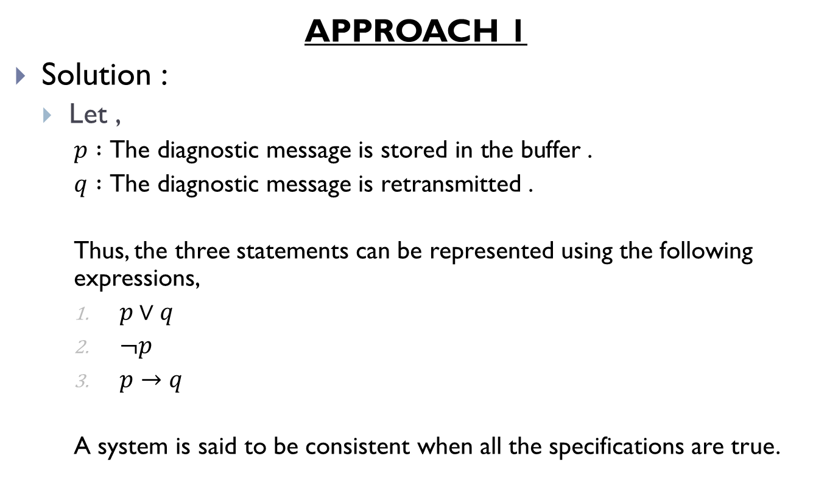
System Specifications(Contd.)
APPROACH 1
Solution :
Let ,
$p :\text{The} \text{diagnostic} \text{message} \text{is} \text{stored} \text{in} \text{the} \text{buffer}$ .
$q :\text{The} \text{diagnostic} \text{message} \text{is} \text{retransmitted}$ .
Thus, the three statements can be represented using the following expressions,
$p∨q$
$¬p$
$p→q$
A system is said to be consistent when all the specifications are true.

Slide 9
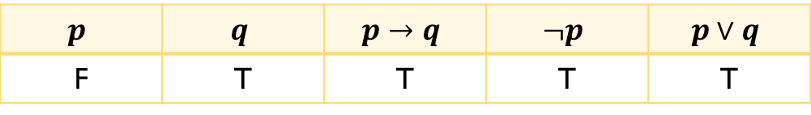
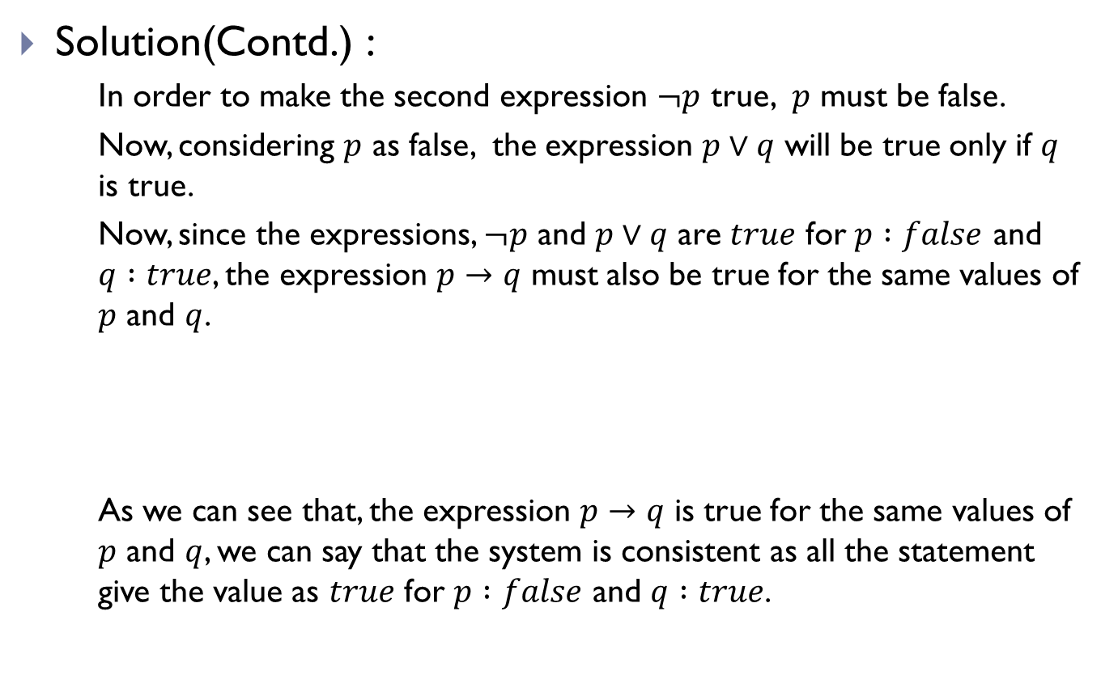
System Specifications(Contd.)
Solution(Contd.) :
In order to make the second expression $¬p$ true, $p$ must be false.
Now, considering $p$ as false, the expression $p∨q$ will be true only if $q$ is true.
Now, since the expressions, $¬p$ and $p∨q$ are $true$ for $p :false$ and $q :true$, the expression $p→q$ must also be true for the same values of $p$ and $q$.
As we can see that, the expression $p→q$ is true for the same values of $p$ and $q$, we can say that the system is consistent as all the statement give the value as $true$ for $p :false$ and $q :true$.
$$p$$ | $$q$$ | $$p→q$$ | $$¬p$$ | $$p∨q$$
F | T | T | T | T

Slide 10
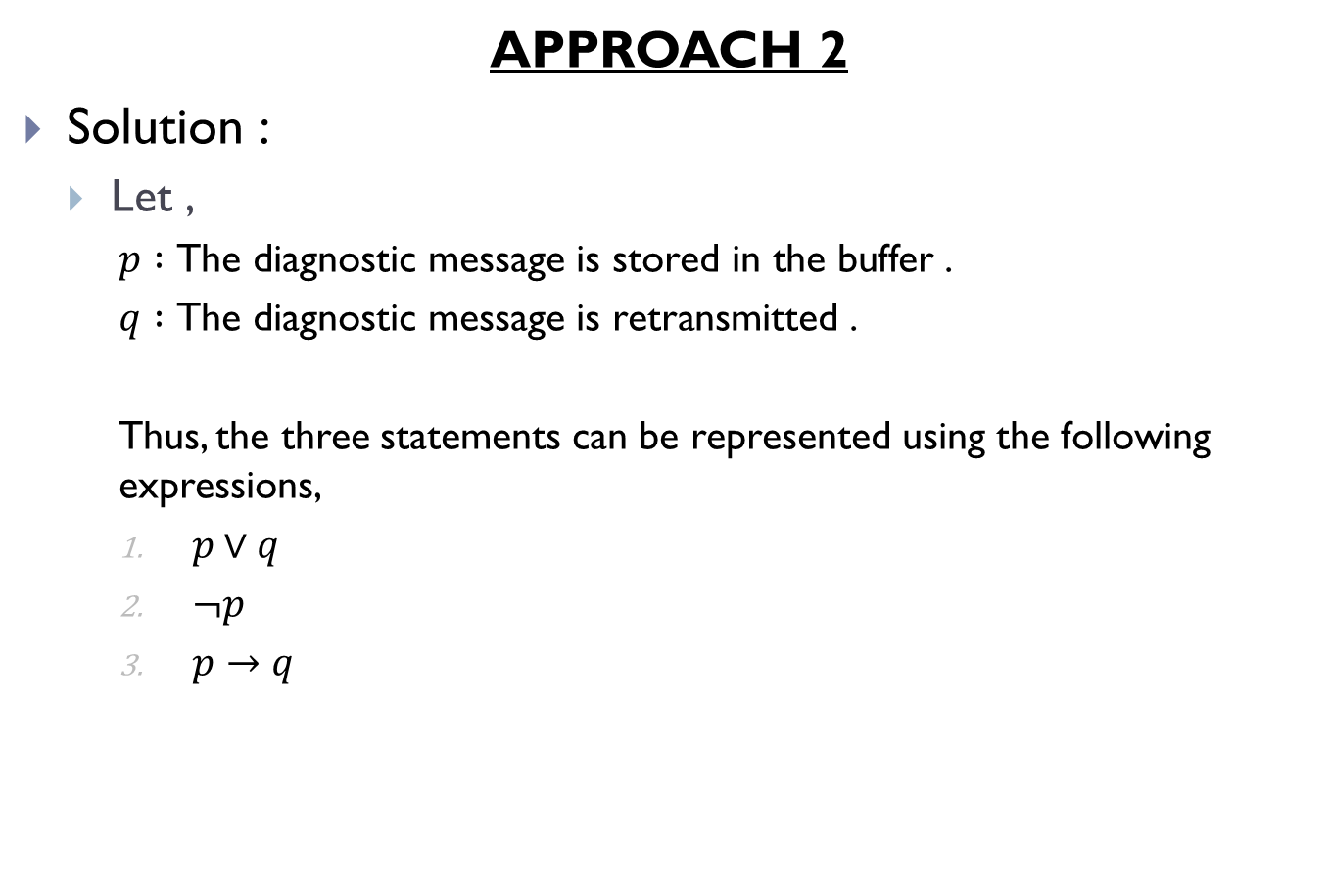
System Specifications(Contd.)
APPROACH 2
Solution :
Let ,
$p :\text{The} \text{diagnostic} \text{message} \text{is} \text{stored} \text{in} \text{the} \text{buffer}$ .
$q :\text{The} \text{diagnostic} \text{message} \text{is} \text{retransmitted}$ .
Thus, the three statements can be represented using the following expressions,
$p∨q$
$¬p$
$p→q$

Slide 11
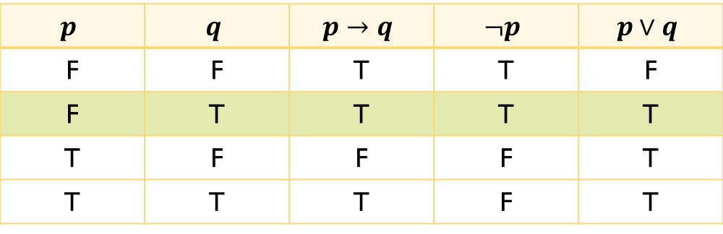

System Specifications(Contd.)
From the truth table we can see that, all the three expressions $p→q$, $¬p$ and $p∨q$ has a truth value of $true$ when $p :false$ and $q :true$.
Thus, we can say that the system is consistent.
$$p$$ | $$q$$ | $$p→q$$ | $$¬p$$ | $$p∨q$$
F | F | T | T | F
F | T | T | T | T
T | F | F | F | T
T | T | T | F | T

Slide 12
System Specifications(Contd.)
Determine whether these system speciﬁcations are consistent:
“The diagnostic message is stored in the buffer or it is retransmitted.”
“The diagnostic message is not stored in the buffer.”
“If the diagnostic message is stored in the buffer, then it is retransmitted.”
“The diagnostic message is not retransmitted.”

Slide 13
System Specifications(Contd.)
Algorithm for checking consistency of a system:
Step 1: Assign variables to all bits and pieces of specifications.
Step 2: Convert the specifications into logical expressions.
Step 3: Construct a truth table containing all the possible combination of the truth values of the total number of variables.
Step 4: Find if there is at least one combination of truth values of the variables such that, all the system specifications turn out to be true.
Step 5: If there is such a combination, the system is consistent, otherwise it is inconsistent.

Slide 14
Logic Puzzles
Solve the following puzzle using logical expressions
An island has two kinds of inhabitants, “knights”, who always tell the truth, and their opposites, “knaves”, who always lie.
You encounter two people A and B. What are A and B, if A says “B is a knight” and B says “The two of us are opposite types?”

Slide 15
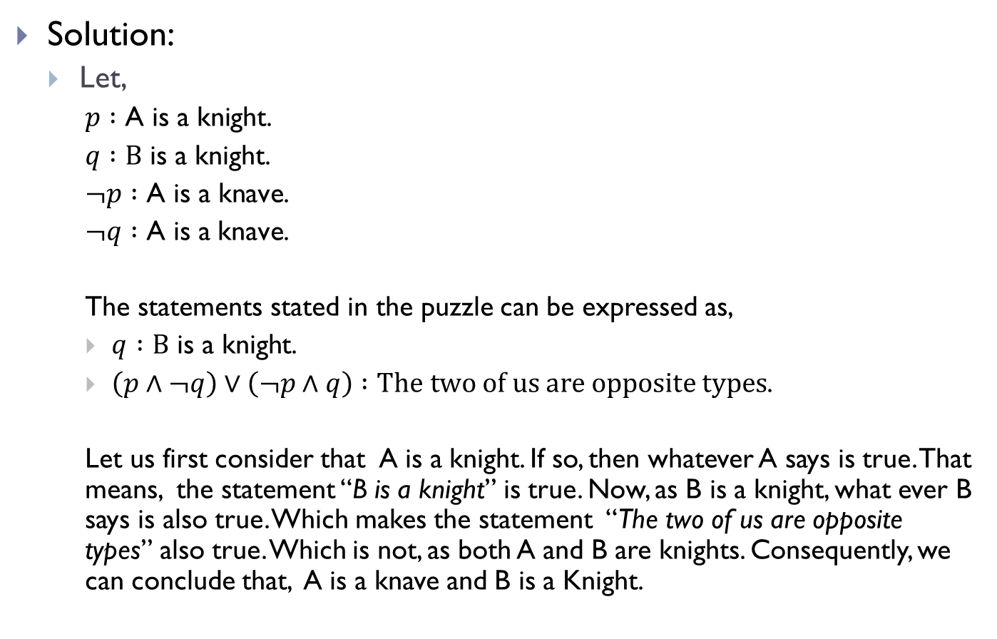
Logic Puzzles(Contd.)
Solution:
Let,
$p :\text{A} \text{is} \text{a} \text{knight}$.
$q :\text{B} \text{is} \text{a} \text{knight}$.
$¬p :\text{A} \text{is} \text{a} \text{kn}\text{ave}$.
$¬q :\text{A} \text{is} \text{a} \text{kn}\text{ave}$.
The statements stated in the puzzle can be expressed as,
$q :\text{B} \text{is} \text{a} \text{knight}$.
$\left(p∧¬q\right)∨\left(¬p∧q\right) :The two of us are opposite types$.
Let us first consider that A is a knight. If so, then whatever A says is true. That means, the statement “B is a knight” is true. Now, as B is a knight, what ever B says is also true. Which makes the statement “The two of us are opposite types” also true. Which is not, as both A and B are knights. Consequently, we can conclude that, A is a knave and B is a Knight.

Slide 16
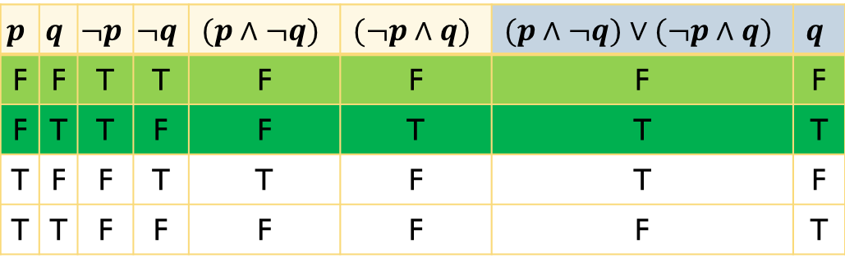
Logic Puzzles(Contd.)
Solution(Contd.):
Again, let us consider that A is a knave. If so, then whatever A says is a lie. That means the statement “B is a knight” is false. i.e. B is also a knave.
Now, if B is a knave, the statement “The two of us are opposite types” is false. Which is consistent with both A and B being knaves.
Let us construct the truth table and see for which combinations of the types of A and B, the truth values of the specifications are consistent.
$$p$$ | $$q$$ | $$¬p$$ | $$¬q$$ | $$(p∧¬q)$$ | $$(¬p∧q)$$ | $$(p∧¬q)∨(¬p∧q)$$ | $$q$$
F | F | T | T | F | F | F | F
F | T | T | F | F | T | T | T
T | F | F | T | T | F | T | F
T | T | F | F | F | F | F | T

Slide 17
Logic Puzzles(Contd.)
Solve the following puzzle using logical expressions
A father tells his two children, a boy and a girl, to play in their backyard without getting dirty. However, while playing, both children get mud on their foreheads. When the children stop playing, the father says “At least one of you has a muddy forehead,” and then asks the children to answer “Yes” or “No” to the question: “Do you know whether you have a muddy forehead?” The father asks this question twice. What will the children answer each time this question is asked, assuming that a child can see whether his or her sibling has a muddy forehead, but cannot see his or her own forehead?
Assume that both children are honest and that the children answer each question simultaneously.

Slide 18
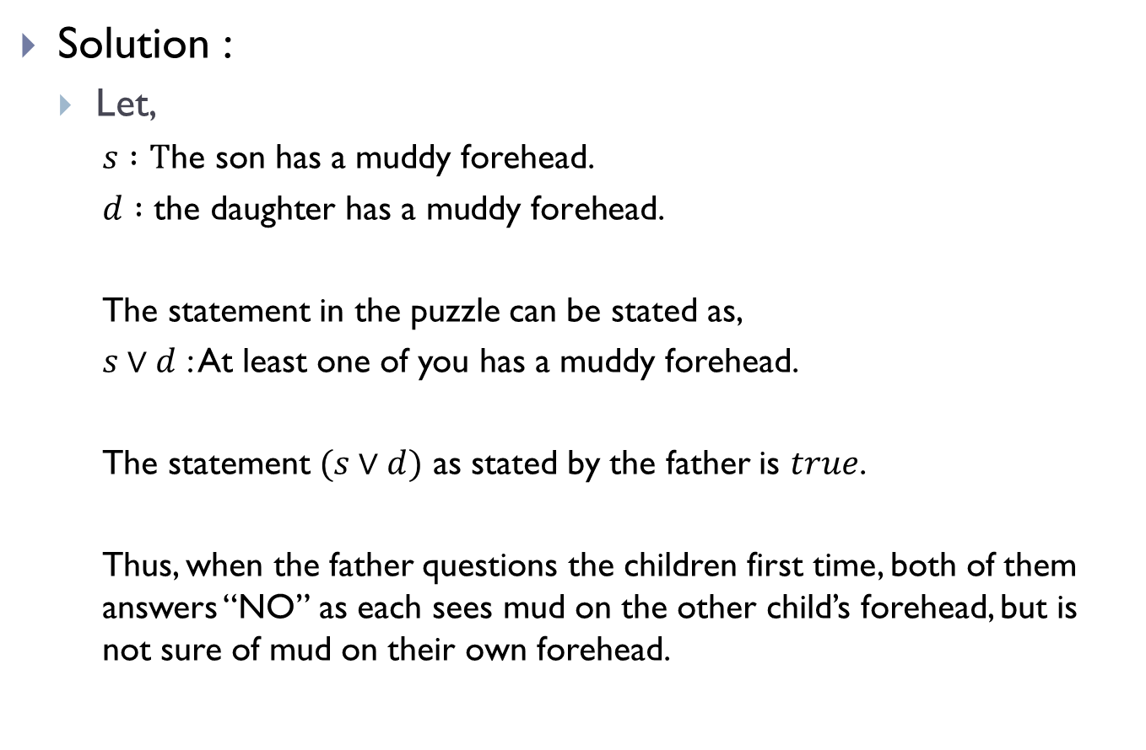
Logic Puzzles(Contd.)
Solution :
Let,
$s :\text{T}\text{he} \text{son} \text{has} \text{a} \text{muddy} \text{forehead}$.
$d :\text{the} \text{daughter} \text{has} \text{a} \text{muddy} \text{forehead}$.
The statement in the puzzle can be stated as,
$s∨d$ : At least one of you has a muddy forehead.
The statement $(s∨d)$ as stated by the father is $true$.
Thus, when the father questions the children first time, both of them answers “NO” as each sees mud on the other child’s forehead, but is not sure of mud on their own forehead.

Slide 19
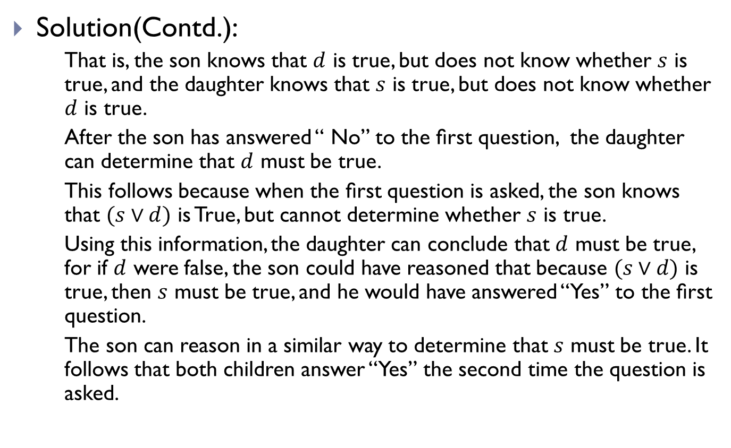
Logic Puzzles(Contd.)
Solution(Contd.):
That is, the son knows that $d$ is true, but does not know whether $s$ is true, and the daughter knows that $s$ is true, but does not know whether $d$ is true.
After the son has answered “ No” to the ﬁrst question, the daughter can determine that $d$ must be true.
This follows because when the ﬁrst question is asked, the son knows that $(s∨d)$ is True, but cannot determine whether $s$ is true.
Using this information, the daughter can conclude that $d$ must be true, for if $d$ were false, the son could have reasoned that because $(s∨d)$ is true, then $s$ must be true, and he would have answered “Yes” to the ﬁrst question.
The son can reason in a similar way to determine that $s$ must be true. It follows that both children answer “Yes” the second time the question is asked.

Slide 20


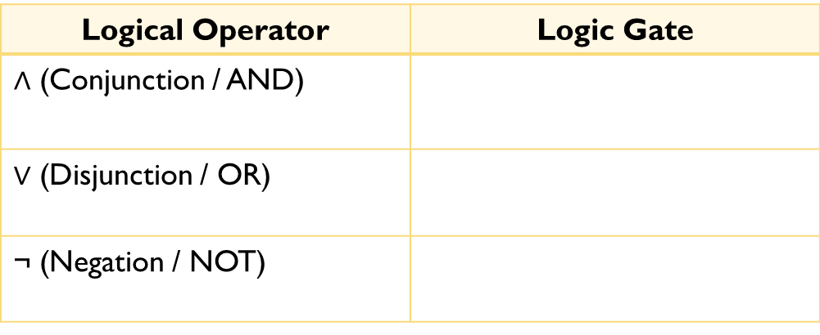
Logic Gates
Logical operators and basic logic gates
Logical Operator | Logic Gate
$∧$ (Conjunction / AND)
$∨$ (Disjunction / OR)
¬ (Negation / NOT)

Slide 21
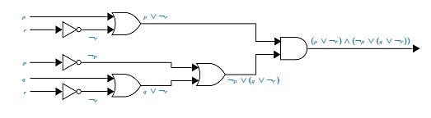

Logic Gates(Contd.)
Express the following expression using logic gates
$(p ∨¬r) ∧ (¬p ∨ (q ∨¬r))$

Slide 22
THE END

